Slide 1
Middle Primary School Rules
2026-2027

Slide 2

Welcome to the 2026–2027 academic year! We are delighted to partner with you in supporting your child's academic, social, and personal growth throughout this academic year.

Slide 3
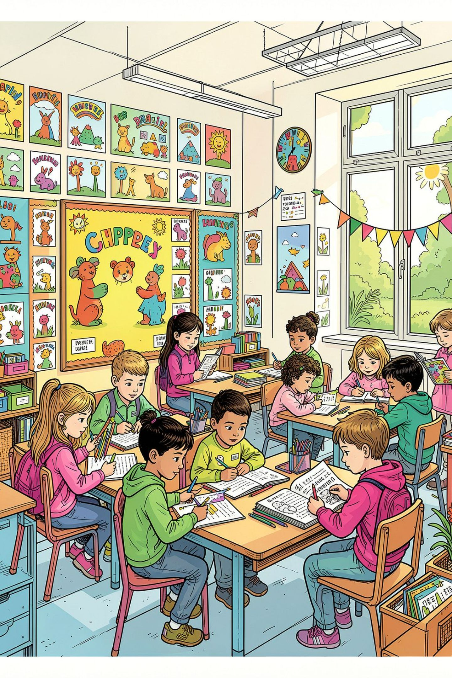
Our Core Philosophy
Quality education goes beyond academic knowledge. It is about building strong academic knowledge while also developing logical, analytical, and creative thinking.

Slide 4
Our Core Philosophy
Academic Knowledge
Critical Thinking
Strong subject foundations built through structured, meaningful learning.
Logical, analytical, and creative problem-solving skills for the future.
Character & Values
Discipline, positivity, resilience, cooperation, and confidence.

Slide 5
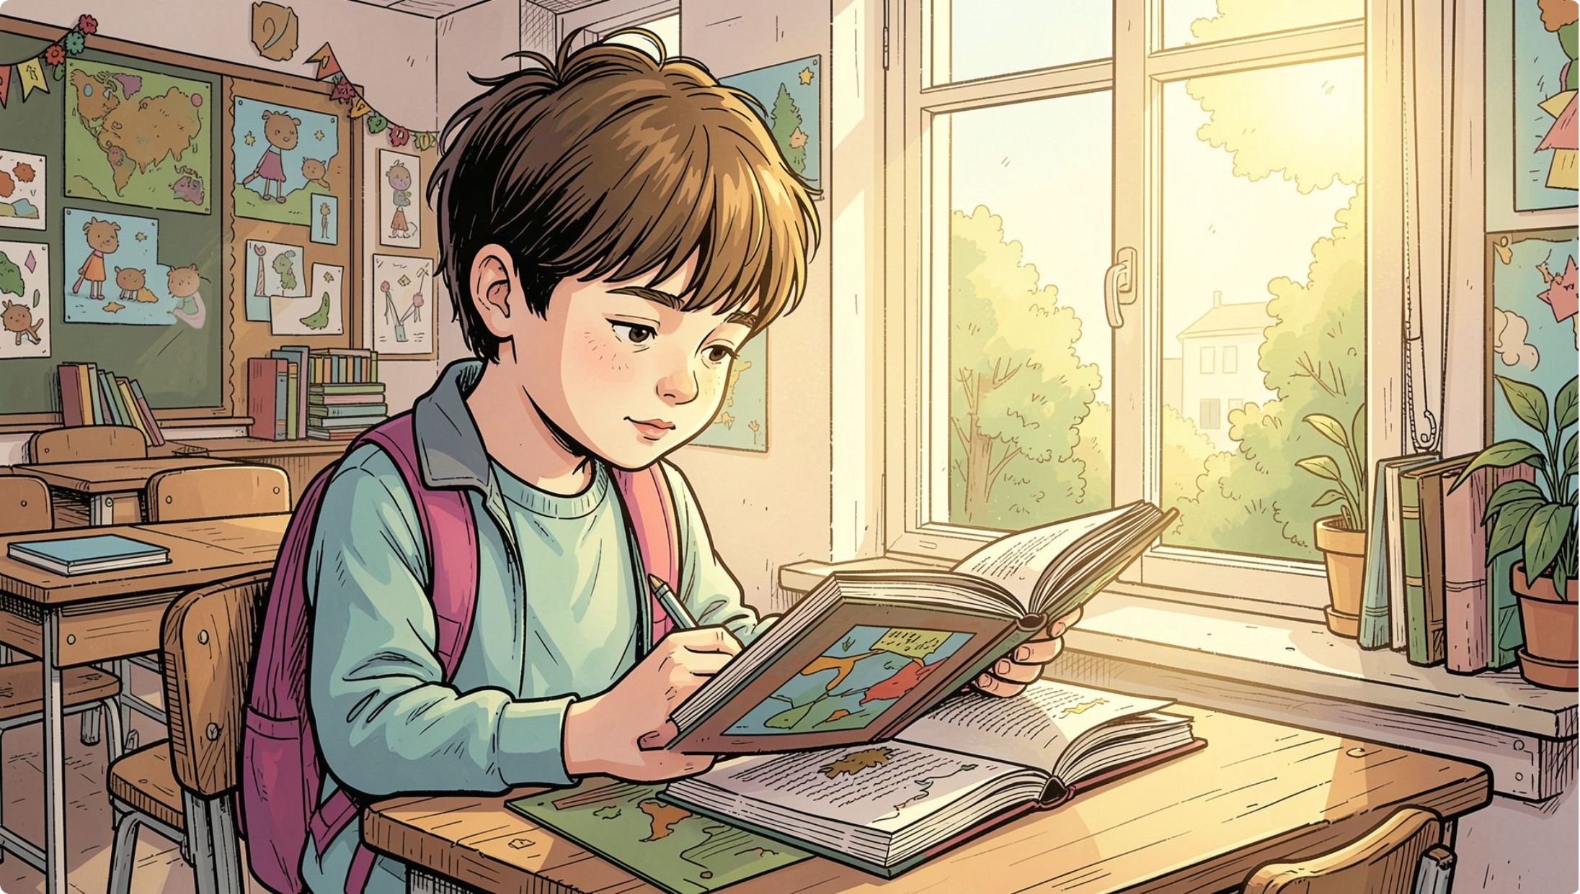
Understanding Your 10–11-Year-Old Child
At this age, children are growing more independent — yet still need your guidance and clear boundaries.
Developing thinking skills
They are moving from simple, concrete thinking
toward more complex and multi-step
problem-solving.
Growth Mindset
Growing Independence
We teach students that mistakes are
opportunities to learn and improve.
They become eager to manage tasks alone,
but still need structure and support.
Taking Responsibility
Peer Influence
Students are beginning to understand that their choices have consequences. Learning from mistakes helps them develop honesty and responsibility.
Friends and social relationships are very important
at this age. A positive classroom community is
essential.

Slide 6
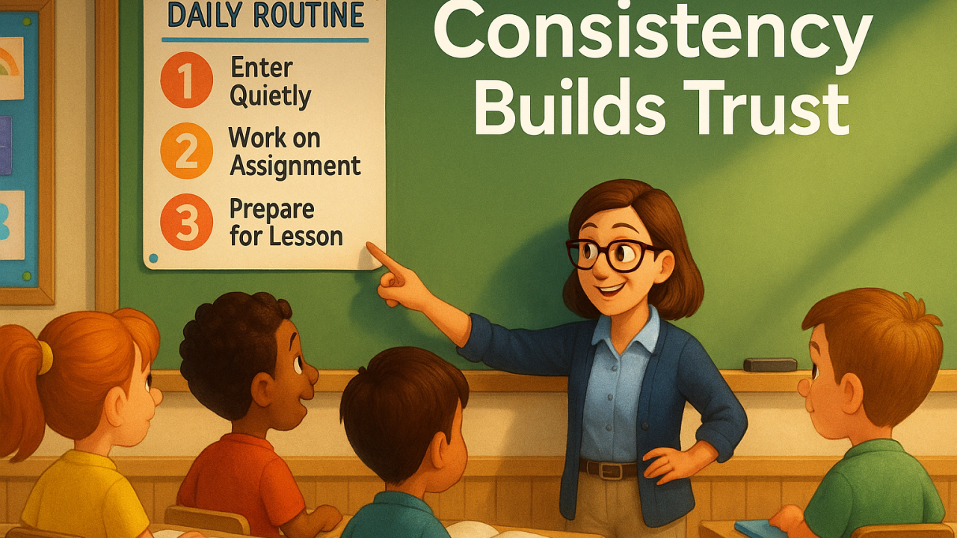
Academic Expectations & Daily Routines

Slide 7

Student Responsibilities
Students are expected to take responsibility for their learning through consistent daily habits.
Come Prepared
Participate Actively
Complete Homework
Bring all required books, files, and stationery to class.
Engage in discussions and complete classwork with focus.
Finish and submit all assignments on time.
Study Regularly
Enrichment Activities
Google Classroom
Review lessons consistently to build strong understanding.
Join research projects, group tasks, and science fairs.
Check Google Classroom for covered topics, homework, notes, required items or any private messages from teachers.

Slide 8

Continuous Assessment
Student progress is monitored regularly through varied approaches — giving a full picture of each child's development.
Weekly Quizzes
Interactive Tasks
Assessment through class participation, research, practical work, and individual or group presentations.
Monthly Assessments
Progress Review

Slide 9

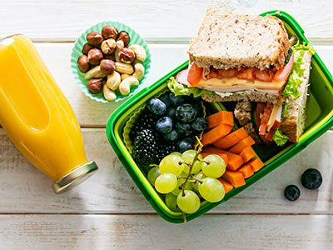
Grooming, Health & Safety
This section covers the daily expectations for personal appearance, health, and safe behaviour at school.

Slide 10
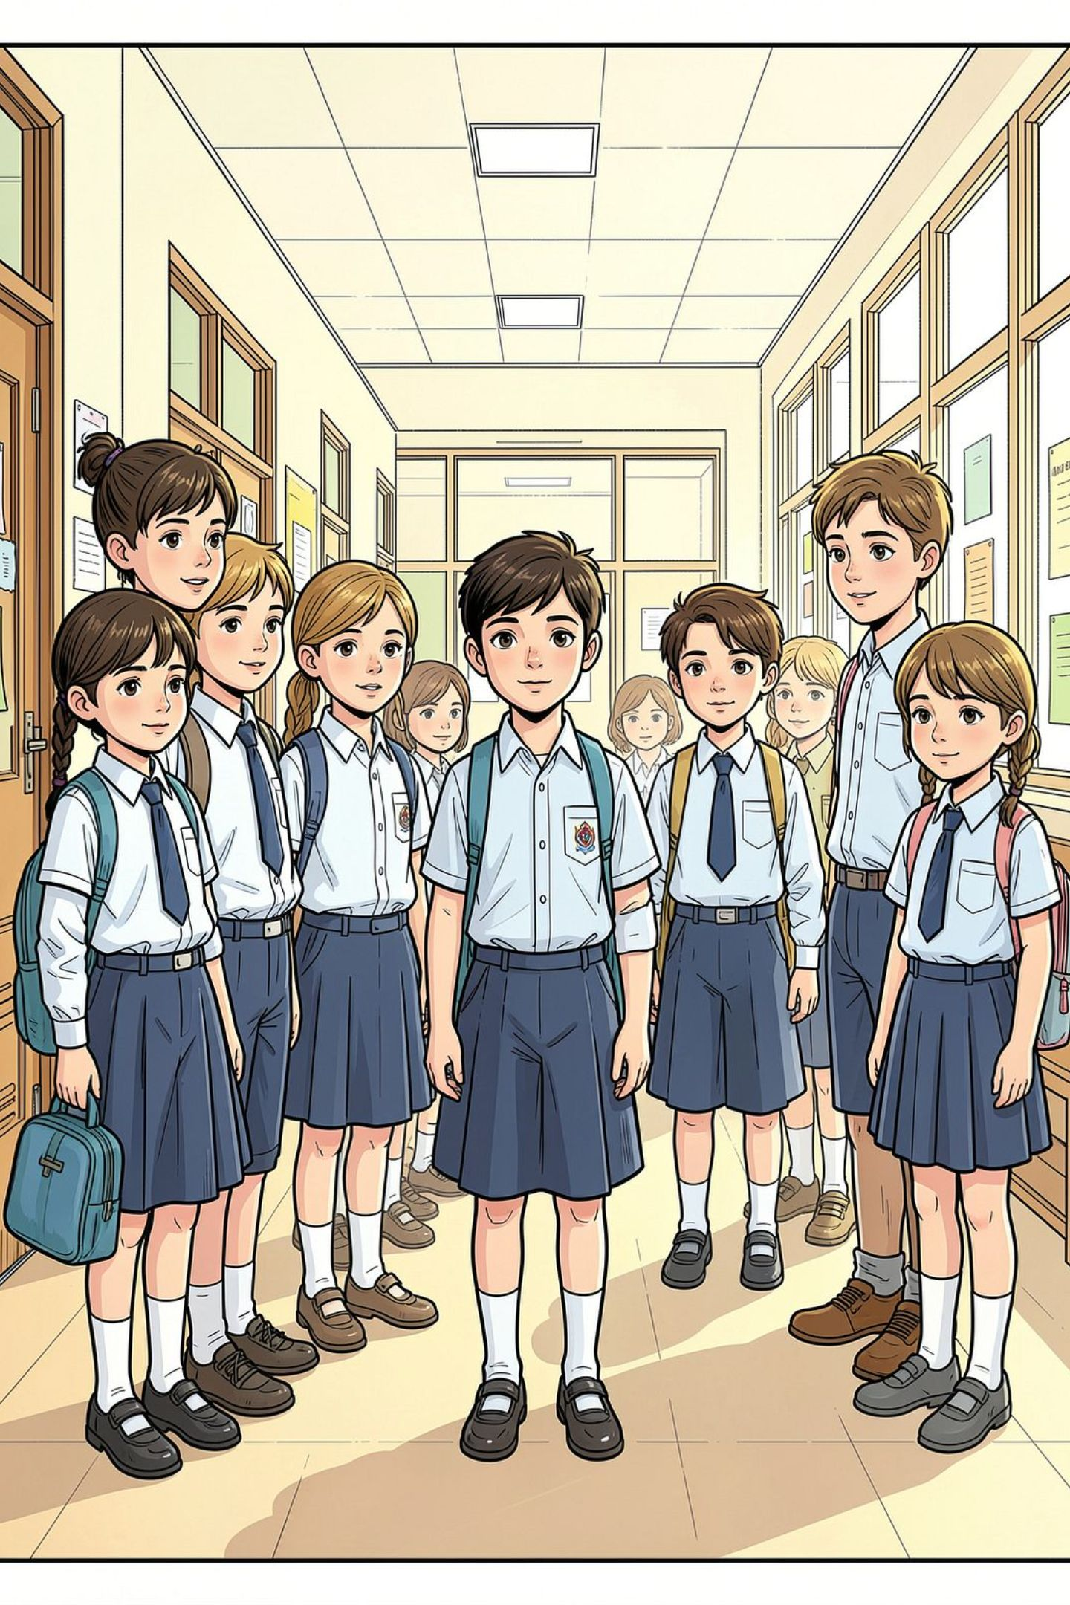
Uniform, Grooming & Personal Cleanliness
A neat appearance helps students stay focused and builds pride in our school community.
Uniform
Clean, well-fitting, pressed and worn properly every day.
Personal Hygiene
Students should follow a regular daily routine that includes
daily showers and fresh undergarments.
The daily use of a mild, scent-free deodorant is encouraged
at this age.

Slide 11
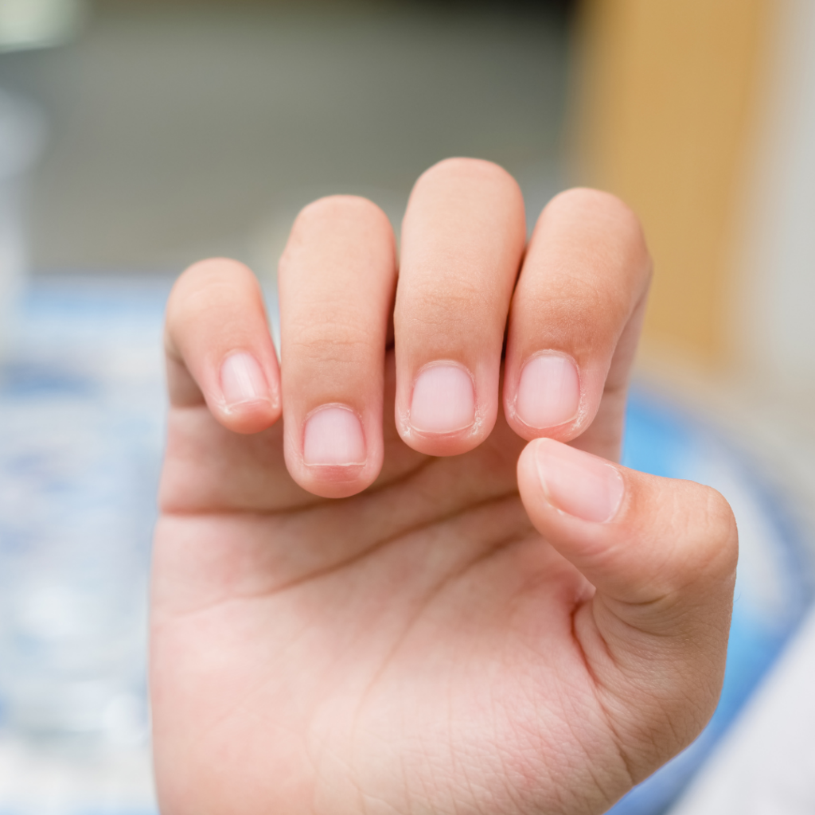



Nails
Nails must be short, clean, and neatly trimmed.
Nail polish is not allowed.

Slide 12





Accessories:
Jewellery should be kept to a minimum. Only simple and safe stud earrings are allowed.
Piercing is not allowed.

Slide 13
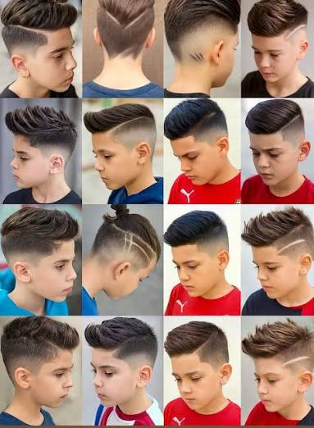
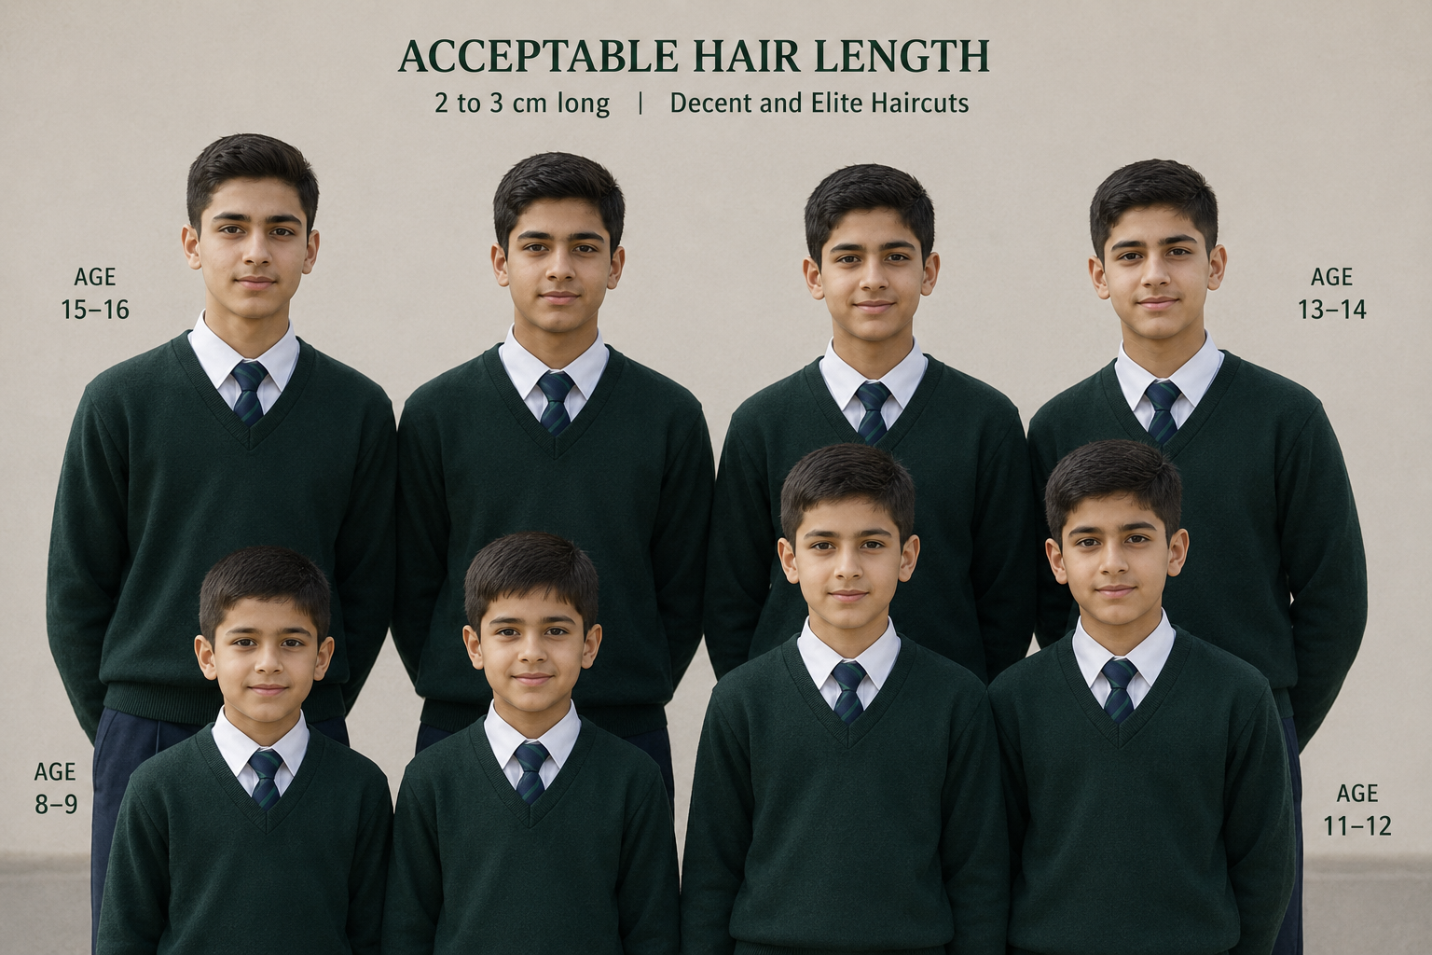
Hair and Hairstyle Rules
For boys: Hair should be neatly cut, kept short, and styled away from the face. Shaved patterns, lines, and asymmetrical styles are not allowed.

Slide 14
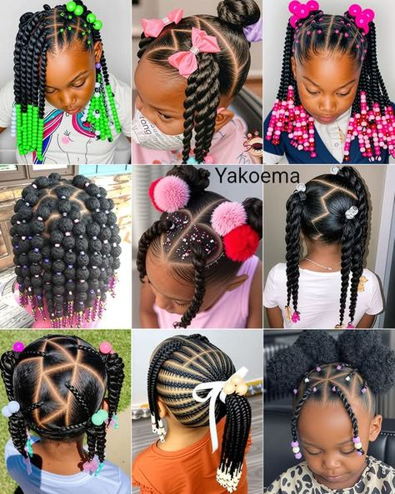
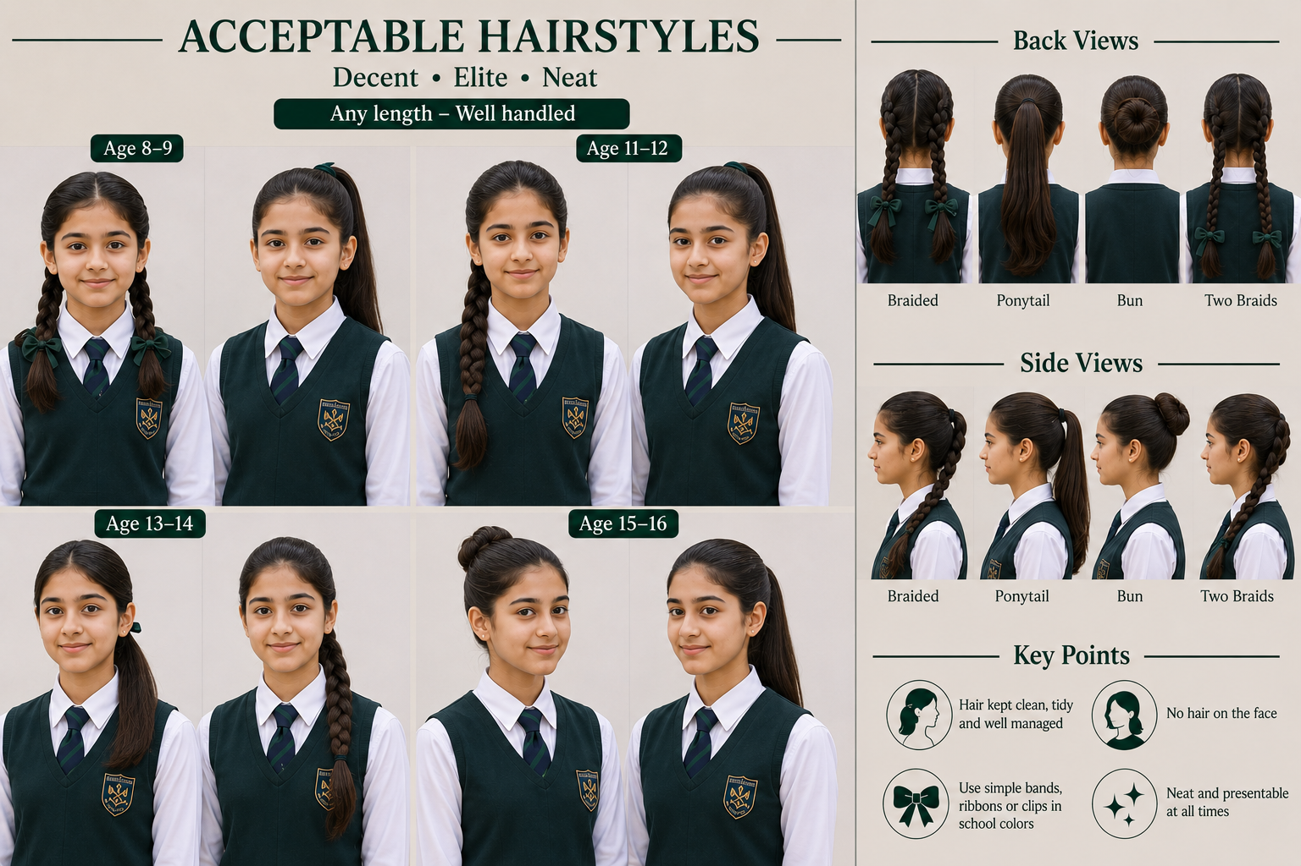
Hair and Hairstyle Rules
For girls: Long hair must be neatly tied back or braided using plain black or white hairbands.
Hair should remain its natural colour. Artificial dyes and prominent henna designs are not allowed.

Slide 15
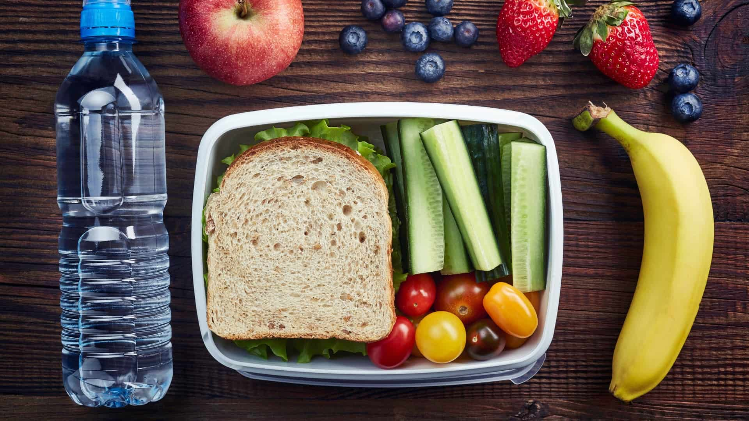

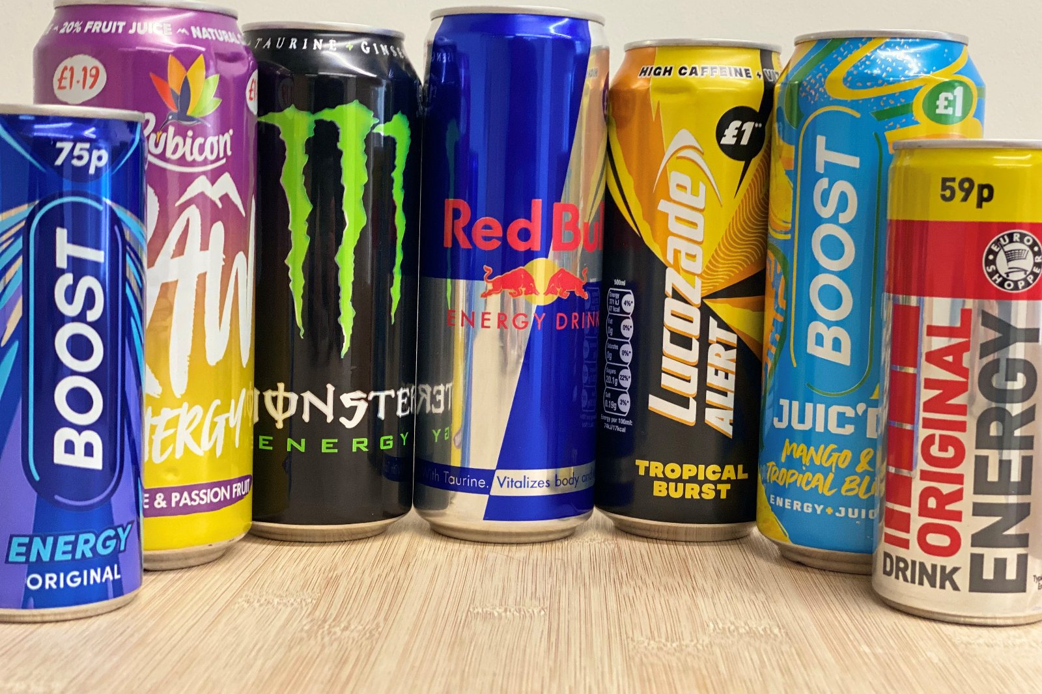
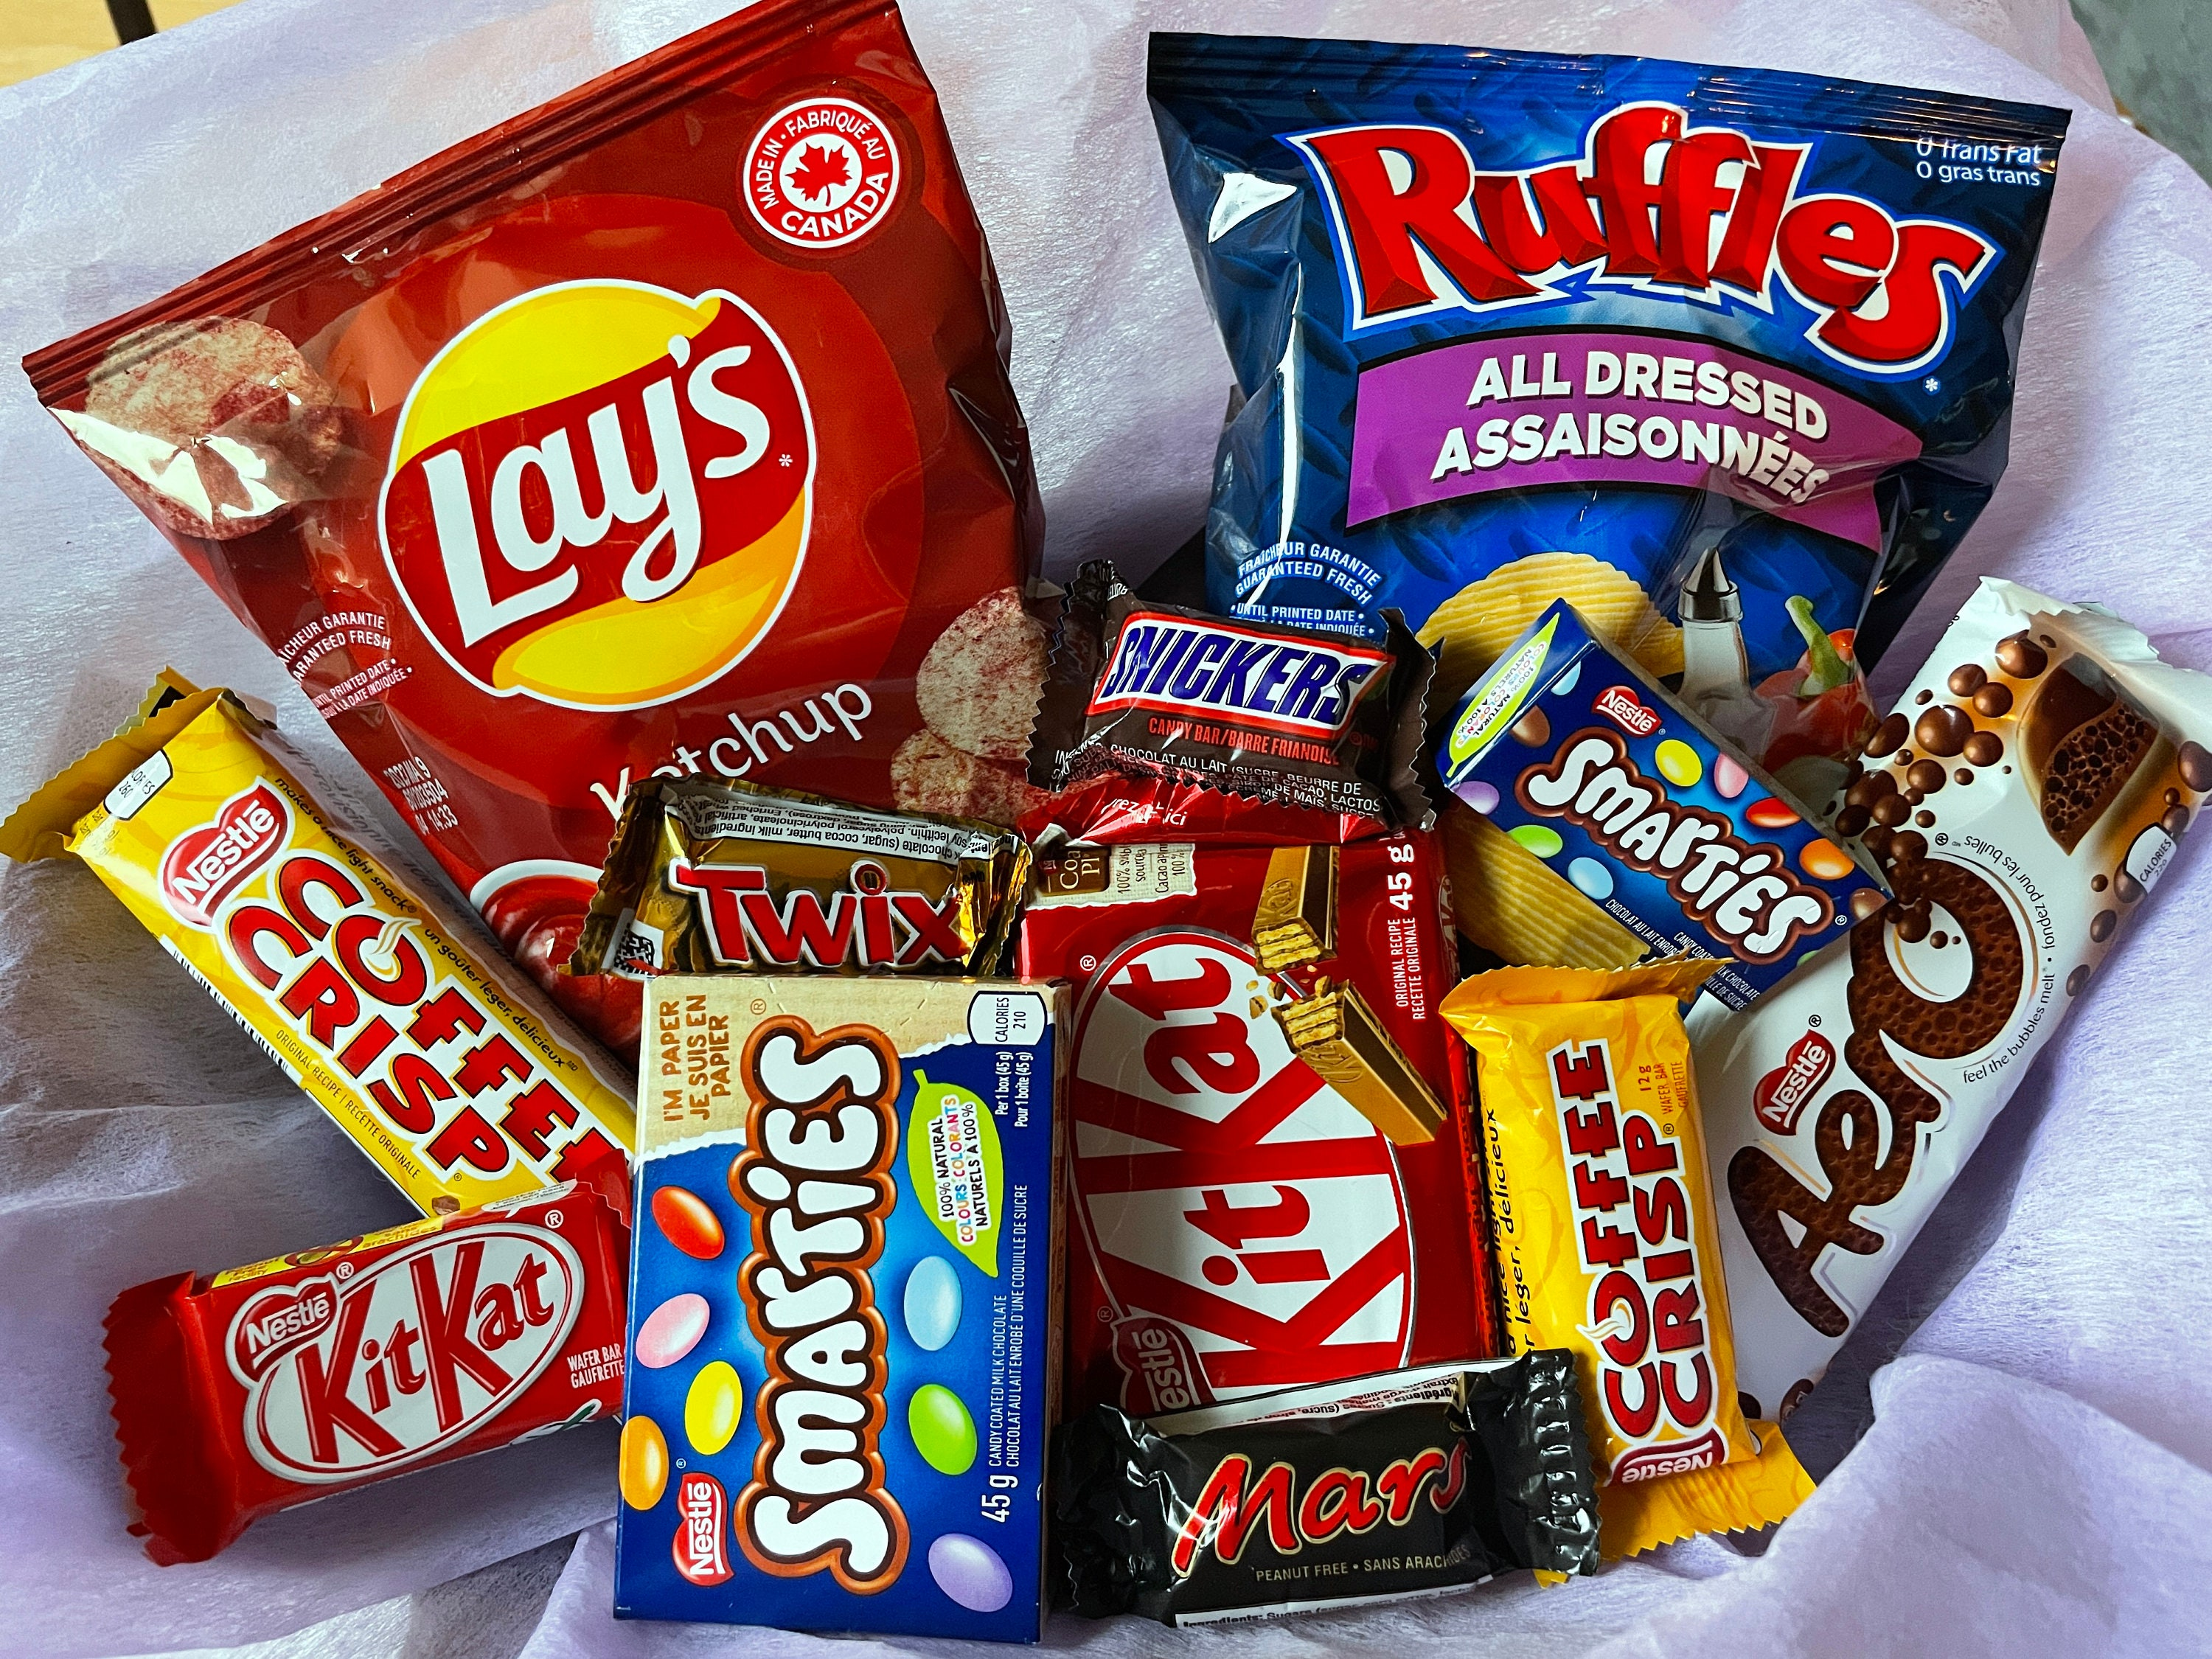
Nutrition & Healthy Habits
Healthy Lunchboxes
Please provide balanced, nutritious meals. Avoid sweets, soft drinks, energy drinks, and junk food. Students should also bring their own water bottle.

Slide 16
Basic Campus Rules
Tardiness: Please ensure that your child arrives at school on time every day. The gate will be closed at 7:45 sharp and no exceptions are allowed.
Absence: If your child is absent for more than 3 days, he or she should bring a note to students’ affairs office explaining the reason for the absence.
Mobile Phones and Smart Watches: Mobile phones and smart watches are not allowed at school. Students must leave them at home.
Bullying: Bullying of any kind is not tolerated. Verbal, physical, or digital bullying, exclusion, or mockery will be taken seriously. We ask parents to encourage kindness, respect, and responsible behaviour.
School Property: Students are expected to respect and take care of all school property.
Trading amongst students: It is totally forbidden for students to carry out any trading activities amongst each other; i.e., selling or buying from each other. Students are not allowed to bring money to school.

Slide 17
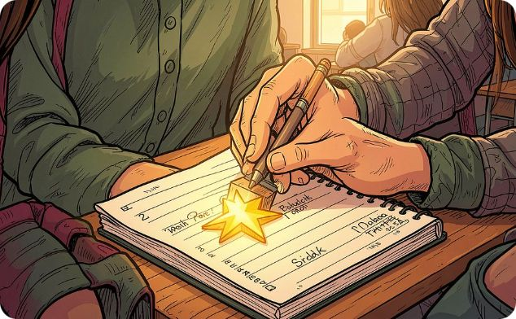

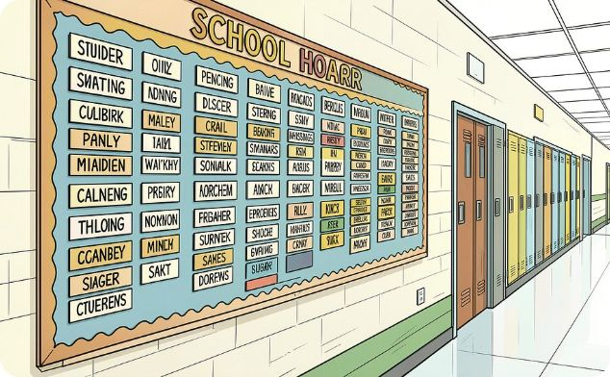
Recognising Success
We celebrate positive behaviour, effort, and academic progress at every level.
Individual Rewards
Classroom Rewards
The Honour Board
Copybook stamps, teacher recognition, and Honour Board mentions for positive behaviour and academic achievement.
Classes are also recognised for excellent neatness, quiet transitions, and positive group behaviour.
Outstanding students are celebrated publicly, reinforcing a culture of excellence and effort.

Slide 18
Progressive Discipline
When students repeatedly disrupt learning or commit serious offences, the school follows a clear process
to address the behaviour.
Behaviours That Require Action
Consequences
Showing disrespect to a teacher, supervisor, or staff member.
Behaving inappropriately or unsafely in the classroom.
Repeated talking or disrupting the lesson.
Using verbal or physical violence toward another student.
Repeated distraction, daydreaming, or lack of attention during tasks.
Repeatedly failing to complete academic responsibilities or submit homework.
Behaviour File
Each incident is documented in the student's record.
Parent Meeting
Continued violations lead to a Record of Warnings and a meeting with parents.

Slide 19

A Special Message to Parents
As your child becomes more independent, your support and guidance remain very important.
Spend time together: Your presence, attention, and support are important.
Build routines: Help your child manage their time and organise their tasks instead of doing the work for them.
Encourage responsibility: Give your child age-appropriate household chores to build accountability.
Use positive guidance: Encourage kindness and empathy. Please avoid hitting, screaming at, or insulting your child.

Slide 20
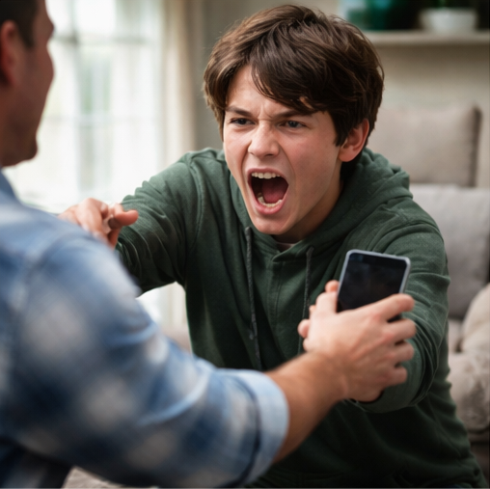

Nurture Healthy Screen Habits: As your child enters Primary 4, they will face a more demanding academic curriculum that requires deeper focus, critical thinking, and sustained attention. While technology is a valuable learning tool, excessive screen time and mobile phone use can significantly hinder their development and school performance.

Slide 21
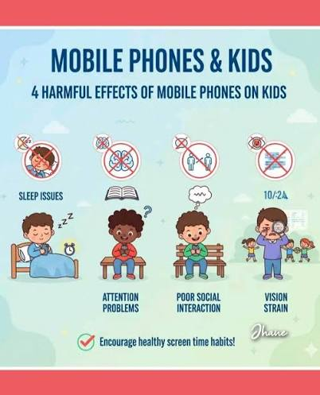
The Negative Effects of Excessive Screen Use:
Reduced Attention Span: Overstimulation from screens makes it harder for students to focus on classroom lessons and reading materials.
Disrupted Sleep: The blue light from mobile devices suppresses melatonin, leading to poor sleep quality and daytime fatigue.
Decreased Physical Health: Extended sedentary behavior contributes to eye strain, poor posture, and less physical activity.
Impacted Social Skills: Relying on digital communication limits opportunities to practice crucial face-to-face social cues and emotional regulation.

Slide 22




We kindly urge parents to establish clear boundaries by limiting non-educational screen time to a maximum of one hour per day. Consider enforcing a "screens off" rule at least one hour before bedtime and replacing device time with reading, outdoor play, or family conversation. Your support at home is vital in helping your child build the healthy habits they need to thrive this school year!
Some helpful applications:
Google Family Link Qustodio Kids360 Microsoft family safety

Slide 23

Communication Channels
Stay Connected
We are one team. Please use the following approved communication channels.
Google Classroom: Check daily for lesson summaries, homework deadlines, learning resources, and private teacher feedback.
Mobile Number: For urgent phone calls and official school SMS updates
Communication with Teachers: Parents may contact teachers by phone during the school day, according to the designated communication timings that will be uploaded and shared on the school website.
Administration access: Appointments with the Head of Stage can be arranged.
E-mail: middleprimary@nrcschools.com

Slide 24


